Slide 1
Median
The only media tracker you’ll ever need

Slide 2





Issue
The modern age has dozens of media platforms and mediums to engage with
Average user uses at least one or two platforms
Difficult to track
Easy to mix things up
Sometimes services mix up progress

Slide 3
Solution
All in one media tracker
Allows you to create and manage individual series and see where you left off
Supports personal series rating, comments, and other series details
Contains links to platforms like wikis
Simple, easy to use
Allows for personal notes on each part of a series

Slide 4
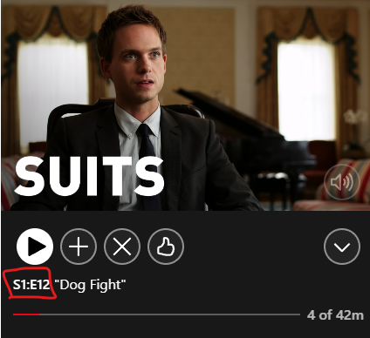
Competition
Built in service trackers utilizing cookies/account data
Individual websites like goodreads specialized for one medium
Fundamental flaw is shared accounts and inconsistent tracking

Slide 5




Tools

Slide 6
Front-end
Back-end
2 main pages
Several input forms with data validation
Other pages like manual and about
2 Core tables
CRUD functionality for both tables
Modular and easily extendable
Create Series
Home
Edit Series
Series
[TABLE]
Details
[TABLE]
Create Details
Edit Details
Series details

Slide 7
Schedule
4/1 - Completed Vuetify testing/planning
4/6 - Back-end architecture finalized
4/13 - Finalized front-end design
4/23 - Testing & back-end complete

Slide 8
Progress
About 450 LoC - Mostly front-end code
Requirements:
5/30 Complete, 16.7% Burndown (Currently on schedule)
Tests: 0/15, 0% Coverage

Slide 9
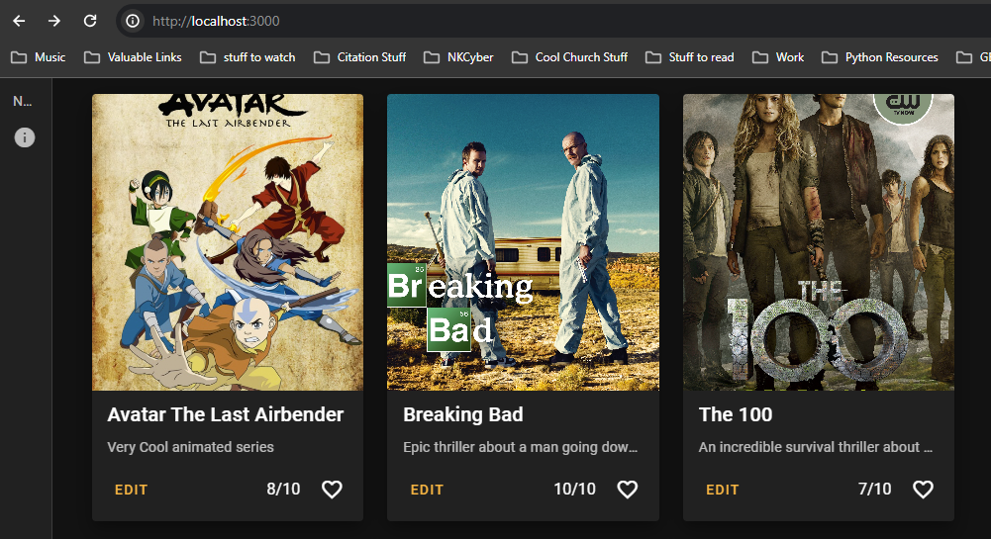
Progress cont.

